Slide 1
Vivek DMDD
File created on: 4/19/22 5:23:09 PM EDT

Slide 2
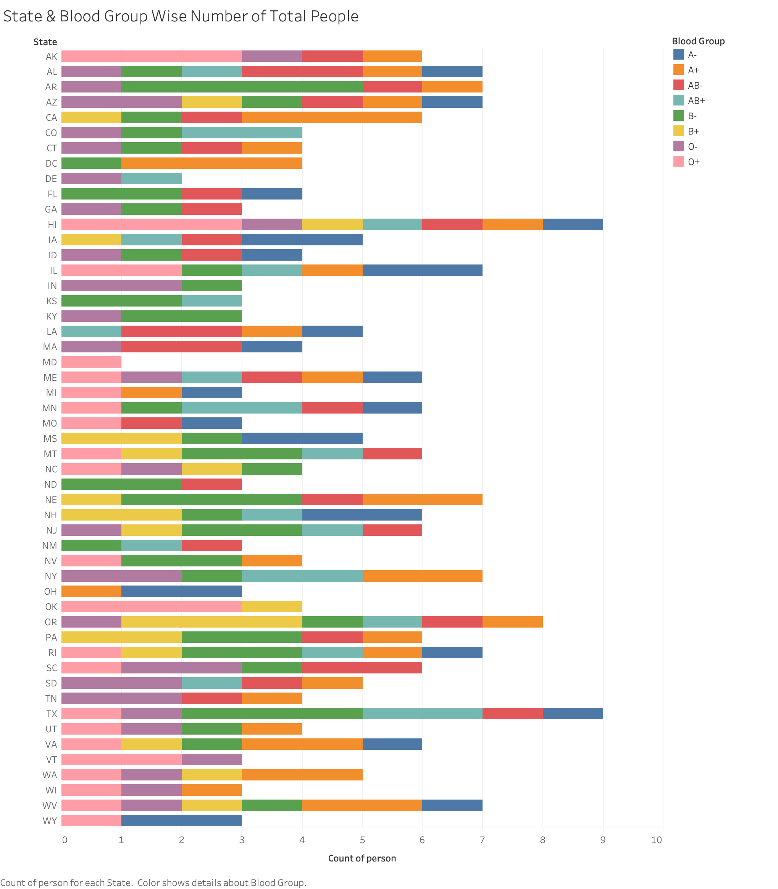

Slide 3
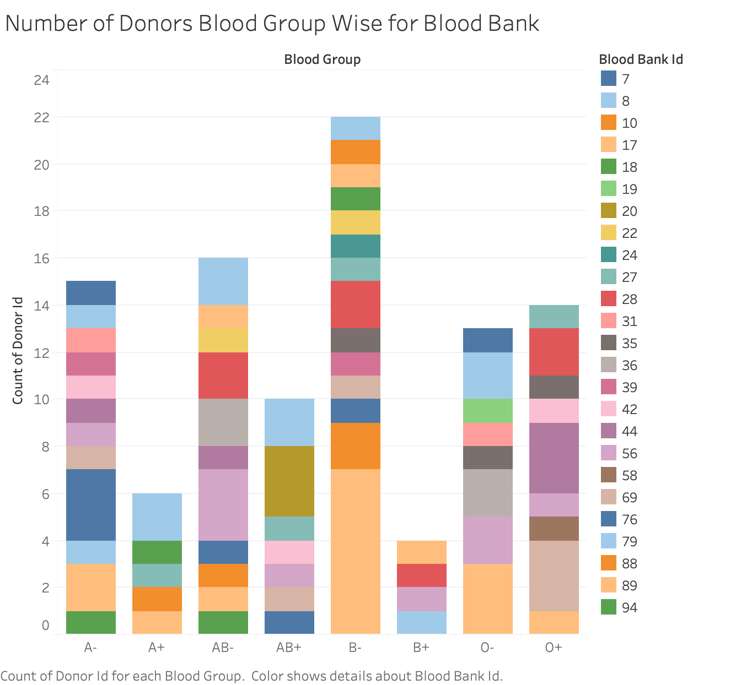

Slide 4
